Slide 1
Linux Part I: Linux Essentials
(http://manuals.bioinformatics.ucr.edu/workshops)
Instructor: Jordan Hayes

Slide 2
Outline
Why Linux?
How to login
File System
File Transfers
Text Files
Useful Tools
File streams
Exercises

Slide 3
Why Linux
Stable - Linux machines can run for years
Powerful remote access - Using bash via remote SSH
Efficient multitasking - Designed for a Multiuser environment
Secure - Open-Source model
Free software - programming languages, applications, databases, open-source projects
Parallelization - Linux clusters (compute farms) provide large storage and memory pools
Various distributions - RedHat, Fedora, Debian, …etc

Slide 4
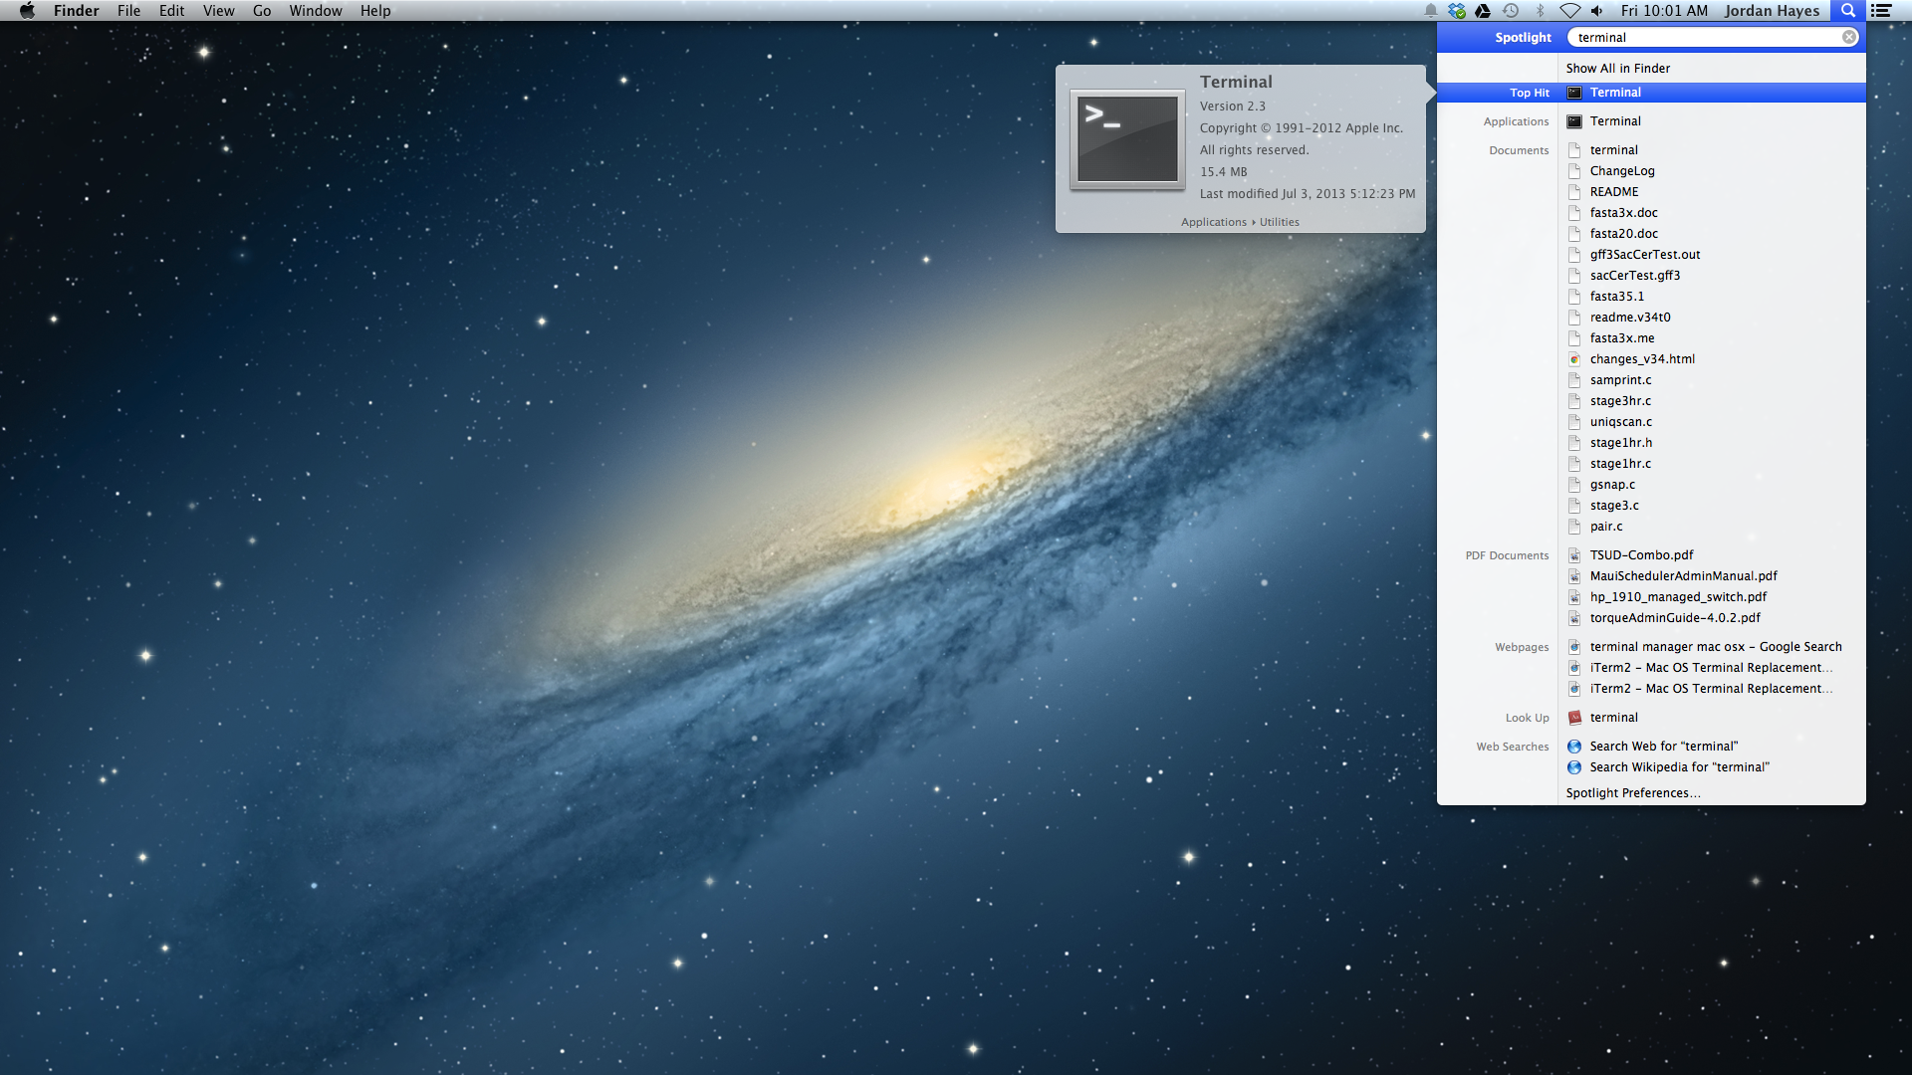
How to login
Type “terminal”
Mac OS X
Click Terminal icon

Slide 5
How to login
Mac OS X
Type within terminal then hit enter:
ssh username@biocluster.ucr.edu
Type password when prompted then hit enter.
Note: Nothing will print when you type, just keep typing

Slide 6
How to login (continued)
Windows
Download putty http://the.earth.li/~sgtatham/putty/latest/x86/putty.exe
Double click putty.exe

Slide 7
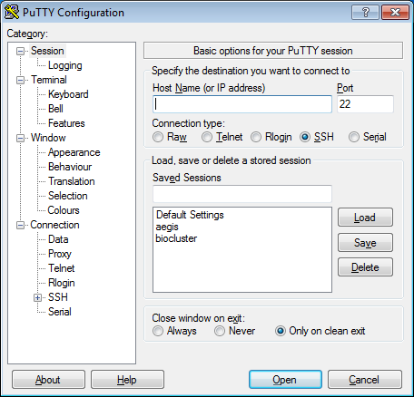
username@biocluster.ucr.edu
Enter user and hostname
Click ‘Open’
A new window will open type your password when prompted then hit the enter key.
Note: Nothing will print when you type, just keep typing
Click

Slide 8
File System
/
Structure
bin
boot
dev
etc
rhome
lib
proc
root
sys
tmp
usr
var
jhayes
jstajich
username
example_dir
example_dir2
example_file
example_file2

Slide 9
File System (continued)
Case sensitive
All paths and commands are case sensitive, an uppercase letter is not the same as a lowercase letter.
Path Types
Absolute path - Full path from top to bottom /rhome/yourname/example_dir/example_file
Relative path - Current working directory is implied example_dir/example_file

Slide 10
File System (continued)
Commands
tree - List files and directories in a tree structure
pwd - Print working directory
ls - List files in directory
touch - Make an empty file
mkdir - Make a directory
cd - Change to directory
cp - Copy file[s] from a directory to a directory
mv - Move file[s] from a directory to a directory
rm - Remove a file
rmdir - Remove an empty directory
Note: ctrl+c will cancel a running command

Slide 11
File System (continued)
Create directories and files:
pwd mkdir example_dir ls cd example_dir touch example_file ls mkdir example_dir2 ls cd example_dir2 touch example_file2
Navigation:
pwd cd .. pwd cd ../../ pwd tree

Slide 12
File System (continued)
File Permissions: viewing
List files in ‘long’ format ls -l
List current directory in ‘long’ format ls -ld
List normal and hidden files in ‘long’ format ls -la

Slide 13
File System (continued)
Permissions are given in the following format:
Not a directory
Owner has read and write
Group has read
Other has read
File Permissions
Every file and directory has permissions:
User read/write/execute
Group read/write/execute
Other read/write/execute
Example:
ls -l filename
-rw-r--r-- 1 user group size date filename
drwxrwxrwx
Directory
User
Group
Other

Slide 14
File System (continued)
File Permissions: setting
Change the ownership of a file (admins only) chown username filename
Change the group association of a file chgrp groupname filename
Change the permissions of a file chmod g+w filename chmod o-r filename chmod u+x filename

Slide 15
File Transfers
Use your internet browser to download this file to your laptop: ftp://ftp.ncbi.nih.gov/genbank/genomes/Bacteria/Acaryochloris_marina_MBIC11017_uid12997/CP000846.faa
Then Open Filezilla

Slide 16
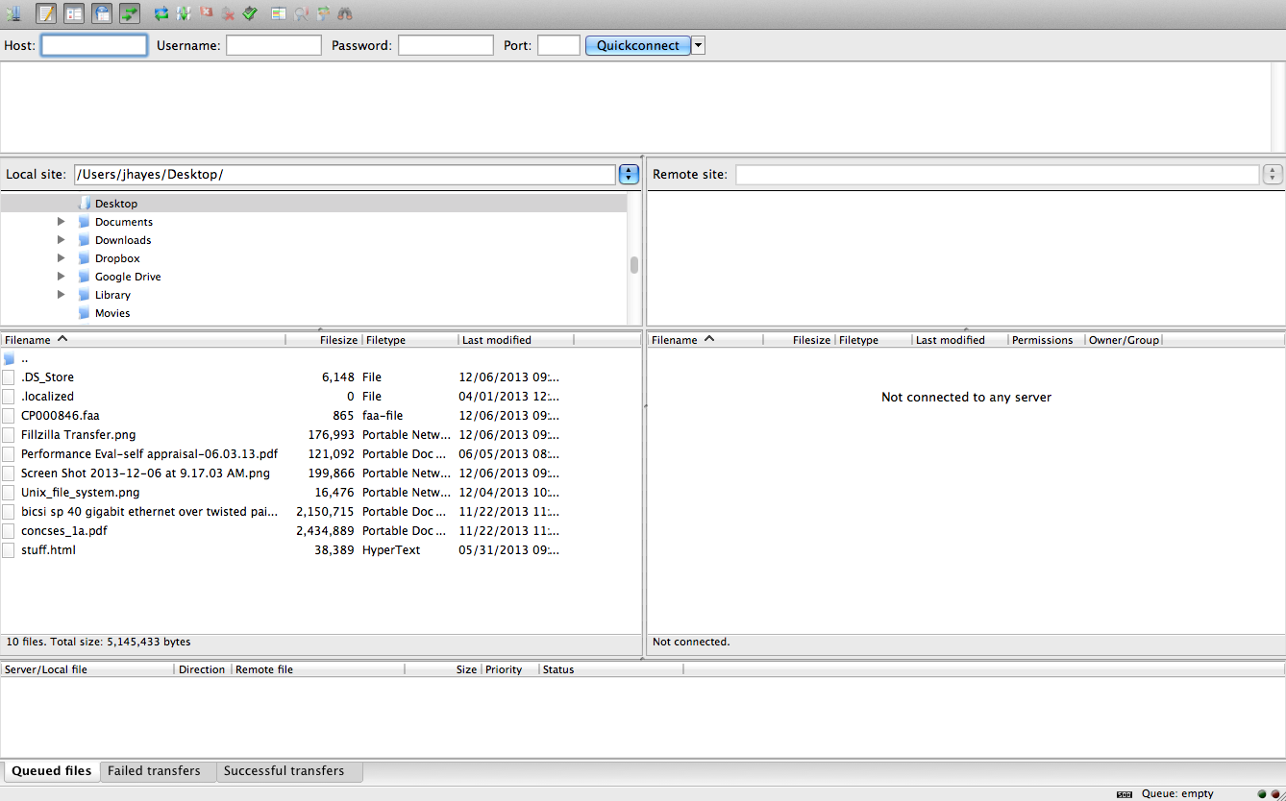
Click
biocluster.ucr.edu
22
Password
Username

Slide 17
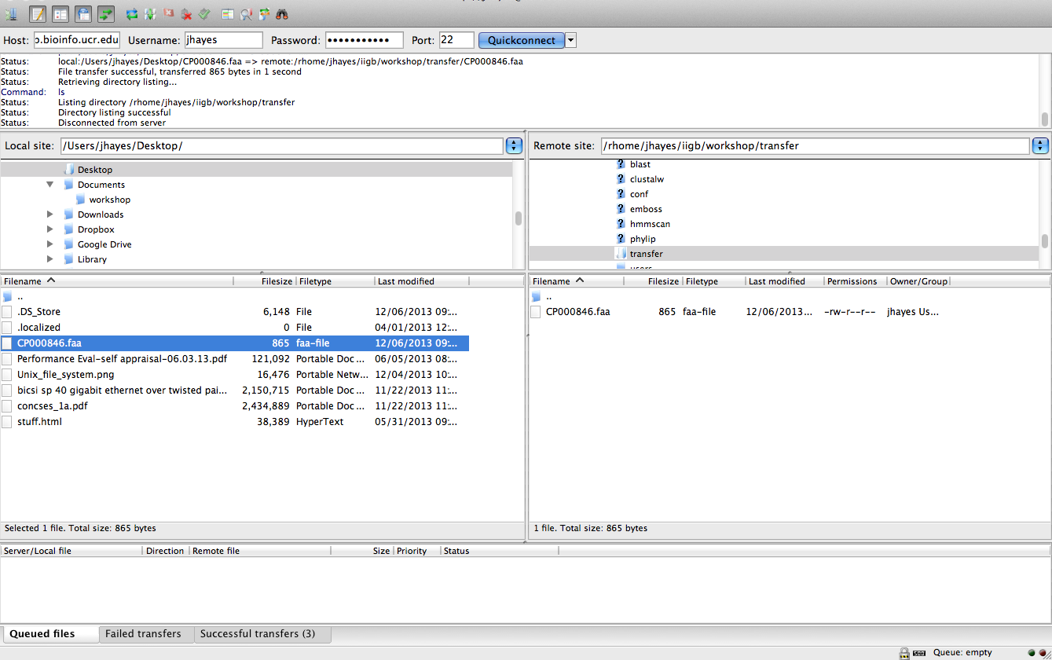
}
Any red error messages?
Drag

Slide 18
File Transfers (continued)
SCP
File transfer utility for Mac/Linux/Cygwin.
scp filename user@host:/path/to/newfile
Example:
scp CP000846.faa username@owl.ucr.edu:/rhome/yourname/
Rsync
rsync -av --progress dir1/ user@host:/path/to/dir2

Slide 19
Text files
Viewers
less
more
Editors
nano
vim
emacs
pico

Slide 20
Useful tools
View list of current processes top # ‘u’ Then type username
# ‘M’ Order by most memory usage
# ‘P’ Order by most CPU usage
Get file from web wget http://url/filename
Word/Line count wc -l filename
Globally search a regular expression and print (pattern match) grep 'pattern' filename
Open manual for a command man commandname

Slide 21
File Streams
STDOUT
Save STDOUT to file ls > list_of_files.txt
Append STDOUT to file ls >> list_of_files.txt
STDIN
Count lines in STDIN wc -l < list_of_files.txt
STDERR
Save error messages to file ls -e 2> errors.txt

Slide 22
File Streams (continued)
Chaining commands: piping
command1 | command2 grep 'pattern' filename | wc -l
command1 | command2 | command3 (...etc) cat filename.csv | cut -f 1 | sort | uniq

Slide 23
Exercises
Basic Prep
Download fasta file wget ftp://ftp.ncbi.nih.gov/genbank/genomes/Bacteria/Halobacterium_sp_uid217/AE004437.faa
View contents (press q to quit) less AE004437.faa
Count how many protein sequences grep '>' AE004437.faa | wc -l
Save all sequence IDs that contain our pattern: awk --posix -v RS='>' '/W.H..(H){1,2}/ { print ">" $0;}' AE004437.faa | grep '^>' | cut -c 2- | cut -f 1 -d\ > myIDs

Slide 24
Exercises (continued)
BLAST
Load the module module load ncbi-blast
Create BLAST database makeblastdb -in AE004437.faa -out AE004437.faa -dbtype prot -hash_index -parse_seqids
Query BLAST database by IDs blastdbcmd -db AE004437.faa -dbtype prot -entry_batch myIDs -get_dups -out myseq.fasta
Run BLAST search for sequences stored in myseq.fasta blastp -query myseq.fasta -db AE004437.faa -outfmt 0 -evalue 1e-6 -out blastp.out

Slide 25
Exercises (continued)
BLAST
Generate CSV BLAST report blastp -query myseq.fasta -db AE004437.faa -outfmt 10 -evalue 1e-6 -out blastp.out
Generate Excel spreadsheet blastp -query myseq.fasta -db AE004437.faa -outfmt 6 -evalue 1e-6 -out blastp.tab

Slide 26
Exercises (continued)
HMMER
Run HMMPFAM search with proteins from BLAST Exercise against Pfam database (will take ~3 minutes):
hmmscan -E 0.1 --acc /srv/projects/db/pfam/current/Pfam-A.hmm myseq.fasta > output.pfam
Easier to parse/process tabular output:
hmmscan -E 0.1 --acc --tblout output_tab.pfam /srv/projects/db/pfam/current/Pfam-A.hmm myseq.fasta
View the tabular output
less -S output_tab.pfam
Notes:
Predictive model

Slide 27
Exercises (continued)
clustalw
Create multiple alignment with ClustalW (e.g. use sequences with 'W.H..HH' pattern):
clustalw myseq.fasta
Copy output file:
cp myseq.aln myalign.aln

Slide 28
Exercises (continued)
EMBOSS
Reformat alignment into PHYLIP format using 'seqret' from EMBOSS:
seqret clustal::myalign.aln phylip::myalign.phylip

Slide 29
Exercises (continued)
PHYLIP
Copy alignment file from EMBOSS exercise:
cp myalign.phylip infile
Creates distance matrix (you may need to press 'R' and then 'Y'):
protdist
Copy distance matrix to new file:
cp outfile infile
Use default settings (press 'Y'):
neighbor
Copy file outtree and rename to intree:
cp outtree intree

Slide 30
Exercises (continued)
View Tree
Use online TreeBrowse http://www.biocluster.ucr.edu/projects/internal/TreeBrowse/
Download and install TreeView http://taxonomy.zoology.gla.ac.uk/rod/treeview.html
X-Forward from server ssh -XY username@biocluster.ucr.edu tv intree
Command Line retree intree #‘Y’ then ‘enter’, ‘M’ then ‘enter’
#‘X’ then ‘enter’ to quit

